Slide 1
Parameter estimation

Slide 2
Outline:
    1 Types of parameters
    2 The criterion
    3 Estimation methods (criteria)
    4 Robust rescaling
    5 Recommendations
    6 Iteration

Slide 3
1 Types of parameters:
Free parameter
are estimated with respect to the data – direct estimation
Restricted parameter
the value of the parameter is set equal to the value of another parameter; the common value of the parameters is estimated – indirect estimation
Fixed parameter
a specific constant value is assigned to the parameter – no estimation

Slide 4
2 The criterion
The different estimation methods mainly differ with respect to the criterion (e.g. least-squares criterion of multiple regression)

Slide 5
2 The criterion
The criterion refers to the way of determining the difference between the empirical matrix (S) and the model-implied matrix (∑) that is specified according to the vector including the parameters of the model (θ).
The difference is frequently described as function F with two entries:
F(S, ∑(θ))

Slide 6
2 The criterion
The criterion refers to the way of determining the difference between the empirical matrix (S) and the model-implied matrix (∑) that is specified according to the vector including the parameters of the model (θ).
The difference is frequently described as function F with two entries that has to be minimized:
F(S, ∑(θ)) → min

Slide 7
2 The criterion
The criterion refers to the way of determining the difference between the empirical matrix (S) and the model-implied matrix (∑) that is specified according to a specific vector of parameters (θ).
The difference is frequently described as function F with two entries that has to be minimized:
F(S, ∑(θ)) → min
Estimation methods mainly differ according to the way of determining the difference

Slide 8
2 The criterion
…
Minimization is usually achived by means of an iterative procedure. This means that θ is successively modified in such a way that the value approaches the minimum:
F(S, ∑(θ)) → min

Slide 9
2 The criterion
…
Minimization is usually achived by means of an iterative procedure. This means that θ is successively modified in such a way that the value approaches the minimum:
F(S, ∑(θ)) → min
A recent development is the consideration of an additional weight matrix W that gives specific emphasis to some individual deviations of the matrices:
F(S, ∑(θ), W) → min

Slide 10
3 Estimation method (criterion)
Formerly the software programs offered several estimation methods
… and the user simply selected the method that provided the best results

Slide 11
3 Estimation method (criterion)
Formerly the software programs offered several estimation methods
… and the user simply selected the method that provided the best results
Recently it is required that the selection is made according to the scale of the data (and the distribution). There are ….
- methods for continuous data
- methods for ordered-categorical data
(- methods for binary data)

Slide 12
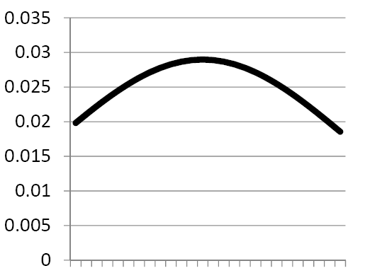
3 Estimation method (criterion)
Maximum likelihood method (ML):
  … returns the parameter values that are expected to show „the highest probability to underly the observed data“
Maximum
Likelihood
resp.
F_{M}
… for value of θ (parameter)
( F(S, ∑(θ)) )

Slide 13
3 Estimation method (criterion)
Maximum likelihood method (ML):
  … returns the parameter values that are expected to show „the highest probability to underly the observed data“
  … is the most frequently used „fitting function“
Discrepancy function (fitting function):
  tr = „trace“ of a matrix p = number of observed variables
  θ : the parameters of the model

Slide 14
3 Estimation method (criterion)
Maximum likelihood method (ML):
Preconditions:
… is recommended for continuous data
… is recommended if multivariate normality is given
… is recommended for correctly specified models
recommended sample size: > 200 (> 400, > 2000)
(depends on literature source and data type)

Slide 15
3 Estimation method (criterion)
Maximum likelihood method (ML):
Advantage:
provides a statistics that follows the χ² distribution
enables statistical testing (χ²)
is efficient, consistent and unbiased in combination with correct specification of the model and given preconditions
Disadvantages:
… because multivariate normality is frequently not given
… in this case -> first-type error

Slide 16
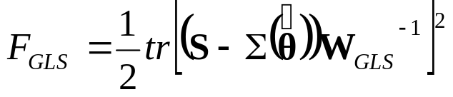
3 Estimation method (criterion)
Generalized least squares (GLS)
… is recommended for continuous data
… requires a large sample size
… differs from ML because of the use of the W matrix
… is not used frequently
Discrepancy function:

Slide 17

3 Estimation method (criterion)
Weighted Least Squares (WLS)
… does not require multivariate normality
… presupposes a large sample size
… is recommended for continuous data
… is recommended for ordered-categorical data
Discrepancy function:
  with s and σ(..) as S and Σ(..) transformed into vectors

Slide 18
3 Estimation method (criterion)
Advantage:
Less sensitive to deviations from normality
In large samples accurate χ² test results and standard errors
Disadvantage:
W⁻¹ matrix used in combination with WLS becomes very large for many indicators so that an investigation may no more be possible (4th derivative)
Very large samples are necessary for achieving accurate estimates
Problems in comparisons between models on the basis of χ²

Slide 19
3 Estimation method (criterion)
Special case:
Unweighted Least Squares (ULS)
    Minimizes the residual matrix
    No precondition regarding the distribution
    No χ² results
    … is seldom applied

Slide 20
4 Robust rescaling
There are rescaling methods for the chi-square value that take deviations from normality into consideration.
Best known and available is the method proposed by Satorra and Bentler. It starts with normal maximum likelihood estimation and subsequently modifies the chi-square value.
The SB-scaled chi-square value is robust to non-normality.

Slide 21
5 Recommendations
If possible, select ML!
In other cases, follow the recommendations by Finney, DiStefano and Kopp (2016) (see next Table)

Slide 22
TYPE OF DATA | Suggestions | Caveats/Notes
Continuous Data
Approximately Normally Distributed | Use ML estimation | The assumptions of ML are met and estimates should be unbiased, efficient, and consistent
Moderately Nonnormal | Use S-B/robust method to correct χ² and standard errors for slight nonnormality | Given the availability of S-B/robust methods in the software packages, one could employ and report findings from both ML estimation and S-B/robust method
(skew < 2, kurtosis < 7) | Use ML estimation, as it is fairly robust to these conditions
Severely Nonnormal | Use S-B/robust method | S-B performs best, although may suffer from loss of χ² power
(skew > 2, kurtosis > 7)

Slide 23
TYPE OF DATA | Suggestions | Caveats/Notes
Ordered Categorical Data
Number of Ordered Categories is 6 or more | Treat data as continuous and use S-B scaling methods with ML estimation | Parameter estimates from S-B/robust approach equal ML-based estimates implying that they will be attenuated to some extent
 | Treat data as categorical and use robust DWLS estimator | Robust DWLS will adjust the parameter estimates, standard errors, and fit indices for the categorical nature of the data
 |  | One could employ and report findings from both estimation methods
Number of Ordered Categories is 5 or less | Treat data as categorical and use robust DWLS estimator | Robust DWLS will adjust the parameter estimates, standard errors, and fit indices for the categorical nature of the data

Slide 24
6 Iteration
The parameter estimation occurs using the …
… Expectation Maximization Algorithmus (EM) - or –special case:
… Newton Raphson Algorithmus
that are iterativ
• The iteration starts with starting values as parameter values giving rise to the model-implied matrix
• The fitting function yields a fit result
• The expectation component of the algorithm revises the parameter values

Slide 25
6 Iteration
The parameter estimation occurs using the …
….
• The fitting function yields a fit result
• The expectation component of the algorithm revises the parameter values
• The fitting function yields a new fit result
• The new and old fit results are compared
… in the case of an improvement in fit ….
• The expectation component of the algorithm revises the parameter values ……………………..
…………………< the iteration goes on >……………

Slide 26
6 Iteration
The parameter estimation occurs using the …
….
• The fitting function yields a fit result
• The expectation component of the algorithm revises the parameter values
• The fitting function yields a fit new result
• The new and old fit results are compared
… in the case of an improvement in fit ….
… in the case of no improvement or reaching the
maximum number of iterations …
End of iteration!

Slide 27
In sum
Chose the estimation method in considering the data!
… what is the scale
… what is the distribution

Slide 28
QUESTIONS REGARDING COURSE UNIT 10
What are the preconditions of the maximum likelihood method?
Which statistic is provided that enables the estimation of the error probability?
What is the reason for selecting a robust estimation method?
Explorative factor analysis

Slide 29
Literature:
Finney, S. J., DiStefano, C., & Kopp, J. P. (2016). Overview of estimation methods and preconditions for their application with structural equation modeling. In K. Schweizer, & C. DiStefano (Eds.), Principles and Methods of Test Construction (pp. 136-165). Göttingen: Hogrefe Publishing.
Kline, R. B. (2011). Principles and practices of structural equation modeling (3rd edition) (Chapter 1: Introduction). New York, NY: The Guilford Press.

